Slide 1
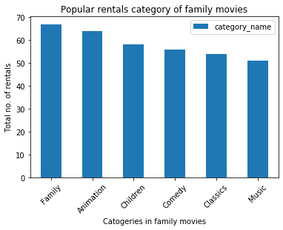
Which category of family movies is least popular?
<visualization>
We see that ‘Music’ category is the least popular of the 6 categories of family movies.

Slide 2
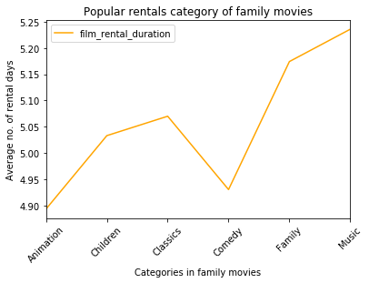
Which category of family movies are rented (on average) for < 5 days ?
<visualization>
Animation and Comedy Categories are (on-average) rented for less than 5 days.

Slide 3
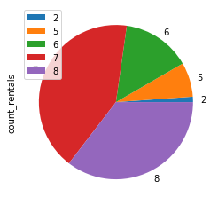
In which month of the year does most rentals occur?
<visualization>
Most no. of rentals (In store1 and store2 combined) occur in 7th month of the year.

Slide 4
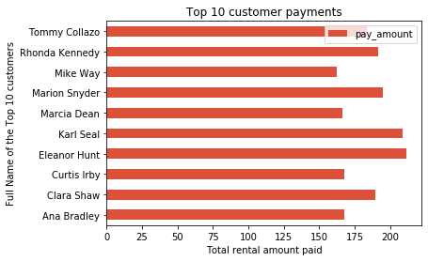
Who among the top 10 customers pays most?
<visualization>
Eleanor Hunt is a valuable customer, who makes a lot of business for the dvd-rental stores.

